Slide 2
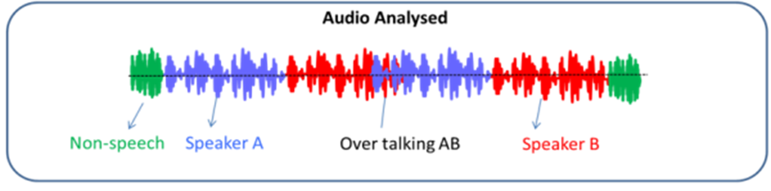
Speaker diarization: partitioning an input audio stream into homogeneous segments according to speaker identity
Answer question “who spoke when”
Application:
Medical records: doctor vs patient separation
Call center data analysis
Improve ASR – speaker boundaries help
Diarization is not speaker change detection → need to care previous speaker
Diarization is not speaker recognition → timestamps are important (need accurate segmentation), No enrollment

Slide 3
Anatomy of a speaker diarization system
Speech Activity Detection (SAD)
Feature / Embedding extraction
Segmentation
Clustering
Post-processing (optional)

Slide 4
Anatomy of a speaker diarization system
Voice/Speech Activity Detection (VAD/SAD) → remove noise and non-speech
Speech Segmentation: extract short segments
Embedding extraction: generate a compact representation for each segment (i-vector, d-vector)
Clustering: assign each segment to a single speaker
Resegmentation(optional)

Slide 5
Speech Activity Detection: detect speech/non-speech in the audio
Energy-based: simple and fast, ineffective for noise like coughing, laughing etc..
Model-based:
models for speech/non-speech, speech/music or noise etc;
Need to be trained with pre-labeled data
Some will only separate speech and silence (VAD)

Slide 6
Feature / Embedding extraction: Convert the speech signal → sequence of vectors that contain speaker-discriminative information
Acoustic features: Different speech sounds are generated by varying the shape of the vocal tract and its mode of excitation
Mel Frequency Cepstral Coefficients (MFCC)
Linear Prediction Cepstral Coefficients (LPCC)
Perceptual Linear Prediction Cepstral (PLPC) Coefficients
Speaker embedding:
Used in speaker recognition first
i-vectors: dimensionality reduction of the GMM supervector, extracted from UBM-GMM framework;
d-vectors: extracted from a DNN, the mean of feature vectors in DNN's final hidden layer.

Slide 7
Segmentation: extract short segments, each containing a single speakers
Fixed-size Sliding Window
Metric-based segmentation: distance metrics are used in conjunction with sliding window to detect the speaker change points

Slide 8
Clustering
Offline
More latency, better result
Post-processing: gap filling, short-segment filtering, resegmentation
K-means, spectral
Online: strictly left-to-right manner
Cluster label determined immediately when embedding is available
Real-time application
Examples:
Naive: online: based on threshold
Link online: Philip Andrew Mansfield (2018)

Slide 9
Two speaker diarization system implemented
1. Fast speaker diarization based on binary keys
2. UIS-RNN developed by google

Slide 10
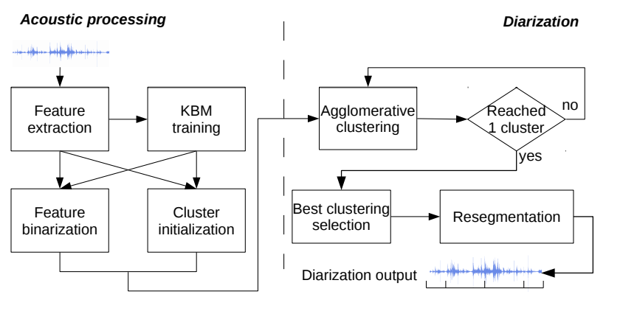
Fast speaker diarization based on binary keys
Feature extraction (MFCCs)
The input feature stream is windowed into frames of given length and overlapping
Binary Key background Model (KBM) is trained internally with in-session content
KBM is used to convert acoustic features into binary features
Agglomerative clustering + resegmentation

Slide 11
Fast speaker diarization based on binary keys
In-session training of a binary key background model (KBM) → does not require any external training data
Clustering: All operations are done with binary data, what makes the process faster than with classic GMM-based approaches.
Can it be online..? Possible sol:
1) We can train the KBM externally using large amount data, then extract BKs in an online manner
2) BK processing → hundredth of realtime; Capture online audio in some buffer to have acceptable data to train the KBM, then use it for the following audio

Slide 12
Unbounded Interleaved-State Recurrent Neural Network (UIS-RNN)
Developed by google
Motivation: Clustering is not good enough in speaker diarization because:
It can’t learn from examples, based on rules
It can’t incorporate temporal information
Supervised diarization: Make full use of speaker labels and their timestamps in training data
Training data → embedding → train UIS-RNN model → predict the speaker in test data

Slide 14
Speaker embedding: extract fixed dim vector from audio
Utterances of same speaker: similar embedding;
Utterances of difference speaker: distinct embedding;
i-vector, d-vector…
Fixed-length segment → neural network (LSTM network) → D-vector

Slide 15
Clustering – not good enough in speaker diarization
Can’t learn from examples, based on rules
Can’t incorporate temporal information
Supervised diarization
Make full use of speaker labels and their timestamps in training data
Domain-specific: train a model in one domain → can’t work well for the others
Training: observation sequence (embeddings),
Label sequence (speakers for embeddings)
Training data → dataset with timestamped speaker label
Small improvements but online
D-vectors ← speaker recognition network; used as known observation

Slide 16
Acoustic processing: map input features → sequence of binary keys
Diariazation: Agglomerative Hierarchical Clustering (AHC) over BKs
Input data → equal-sized segments → binary key (BKs) or cumulative vector (CV) is extracted
Binary key background model (KBM) training:
Input feature stream → frames (each frame trained by a Gaussian model) → pool of Gaussian components → select the most dissimilar Gaussian

Slide 17
agglomerative clustering approach: All operations are done with binary data, what makes the process faster than with classic GMM-based approaches.

